Slide 1
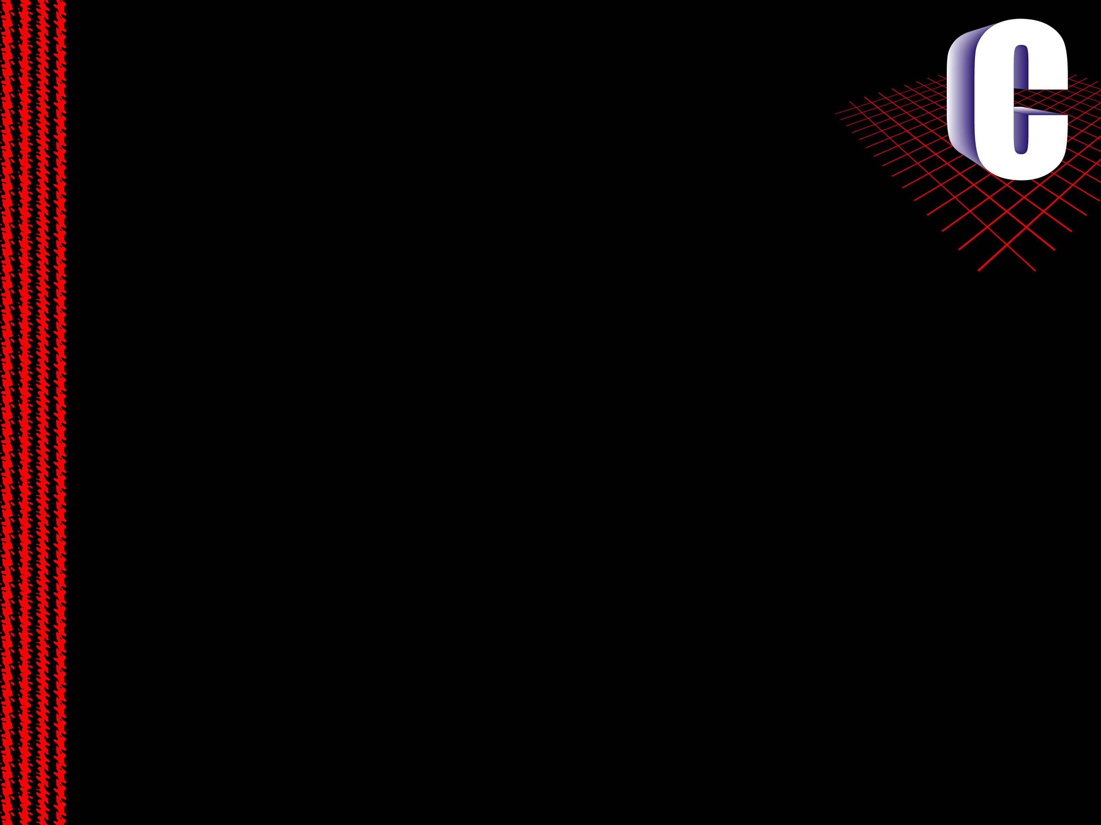
Session 5
Pointers

Slide 2
Session Objectives (1)
Explain what a pointer is and where it is used
Explain how to use pointer variables and
pointer operators
Assign values to pointers
Explain pointer arithmetic
Explain pointer comparisons
Explain how pointers can be passed as arguments
to functions

Slide 3
Session Objectives (2)
Explain pointers and single dimensional arrays
Explain pointers and multidimensional arrays
Explain how allocation of memory takes place
Explain the use of array of pointers
Explain multiple indirection
Explain how pointer to functions can be used

Slide 4
What is a Pointer?
A pointer is a variable, which contains the address of a memory
location of another variable.
If one variable contains the address of another variable, the first
variable is said to point to the second variable.
A pointer provides an indirect method of accessing the value of
a data item.
Pointers can point to variables of other fundamental data types
like int, char, or double or data aggregates like arrays or
structures.

Slide 5
What are Pointers used for?
Pointers are used in situations when passing actual values is
difficult or not desired.
Some of the situations where pointers can be used are -
To return more than one value from a function.
To pass arrays and strings more conveniently from one
function to another.
To manipulate arrays easily by moving pointers to them
instead of moving the arrays itself.
To allocate memory and access it (Direct Memory
Allocation).
To create complex data structures, such as linked lists.

Slide 6
Pointer Variables
A pointer declaration consists of a base type, a *, and a variable
name.
General declaration syntax is : -
type *name;
For Example:
int *var2

Slide 7
Pointer Operators (1)
There are 2 special operators which are used with pointers :
*
The second operator * is the complement of &. It is a unary operator
and returns the value contained in the memory location pointed to by
the pointer variable’s value.
temp = *var2;

Slide 8
Pointer Operators (2)
&
The & operator is a unary operator and it returns the memory address
of the operand.
var2 = &var1;

Slide 9
Assigning Values To Pointers
Values can be assigned to pointers through the & operator.
The assignment statement will be -
ptr_var = &var;
Here the address of var is stored in the variable ptr_var.
It is also possible to assign values to pointers through another pointer
variable pointing to a data item of the same data type.
ptr_var = &var;
ptr_var2 = ptr_var;

Slide 10
Assigning Values To Pointers - I
Variables can be assigned values through their pointers as well.
*ptr_var = 10;
The above declaration will assign 10 to the variable var if ptr_var
points to var.

Slide 11

Pointer Arithmetic
Addition and subtraction are the only operations that can be
performed on pointers.
Take a look at the following example :
Let var be an integer type variable
having the value 500 and stored at the
address 1000.
Then ptr_var has the value 1000 stored in it.
Since integers are 2bytes long, after the expression “ptr_var++;”
ptr_var will have the value as 1002 and not 1001.

Slide 12
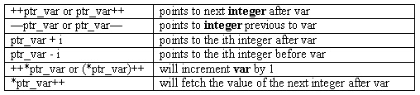
Some More Examples
Each time a pointer is incremented, it points to the memory location
of the next element of its base type.
Each time it is decremented it points to the location of the previous
element.
All other pointers will increase or decrease depending on the length
of the data type they are pointing to.

Slide 13
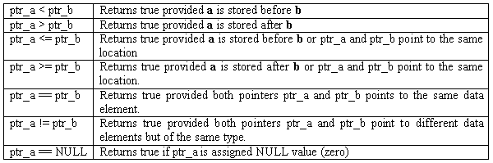
Pointer Comparisons
Two pointers can be compared in a relational expression provided
both the pointers are pointing to variables of the same type.
Consider that ptr_a and ptr_b are 2 pointer variables, which point to
data elements a and b. In this case the following comparisons are
possible:

Slide 14
Pointers as Function Arguments
When pointers are passed to a function:
The address of the data item is passed and thus the function can
freely access the contents of that address from within the function
The program routine can access the variables that lie within the
scope of the function.

Slide 15
Pointers as Function Arguments - I
The function as well as the calling routine recognizes any change
made to the contents of the address.
In this way, function arguments permit data-items to be altered in the
calling routine and the function.
When the arguments are pointers or arrays, a call by reference is made
to the function as opposed to a call by value for the variable arguments.

Slide 16
Function Definition
getstr (char *ptr_str, int *ptr_int)
indicates that the arguments ptr_str points to type char and ptr_int
points to type int.
The function can be invoked by the statement,
getstr (pstr, &var)
where pstr is declared as a pointer and the address of the variable var
is passed.

Slide 17
Pointers and Single Dimensional Arrays (1)
The address of an array element can be expressed in two ways :
By writing the actual array element preceded by the ampersand
sign.
By writing an expression in which the subscript is added to the
array name.
The following program shows the relationship between array
elements and their addresses.

Slide 18
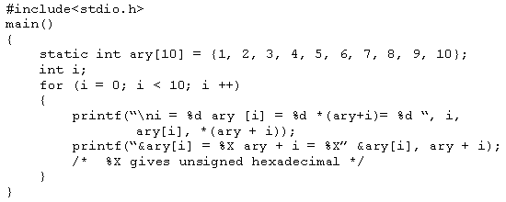
Pointers and Single Dimensional Arrays (2)
Program

Slide 19
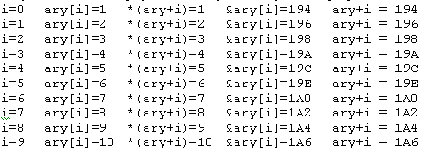
Pointers and Single Dimensional Arrays (3)
Output

Slide 20
Pointers and Multidimensional Arrays (1)
A two-dimensional array can be defined as a pointer to a group of
contiguous one-dimensional arrays.
A two-dimensional array declaration can be written as :
data_type(*ptr_var) [expr 2];
instead of
data_type(*ptr_var) [expr1] [expr 2];
parentheses that surround the array name and the preceding asterisk
in the pointer version of each declaration

Slide 21
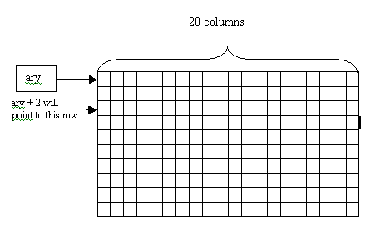
Pointers and Multidimensional Arrays (2)
For example:
int (*ary) [20];

Slide 22
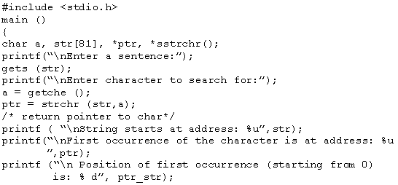
Pointers & Strings (1)
Using strings as pointers can be explained with the help of the
Example

Slide 23

Pointers & Strings (2)
Output

Slide 24
Allocating Memory (1)
The following example uses a two-dimensional array to record
marks of 5 students for 10 subjects.
It uses pointers and malloc() function, to assign memory.
The allocation of memory in this manner, that is, as and when
required in a program is known as Dynamic memory allocation.

Slide 25
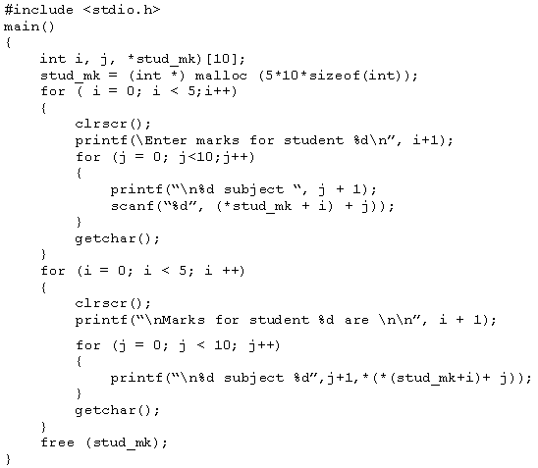
Allocating Memory (2)

Slide 26
Dynamic Memory allocation
A C program can store information in the main memory of the computer in two primary ways
  global and local variables
  C’s Dynamic Allocation System
In the second method, storage for information is allocated from the
pool of free memory as and when needed
The malloc() function is one of the most commonly used functions
which permit allocation of memory from the pool of free memory
The free() function releases the memory pointed to by the pointer,
and make memory available for future allocation

Slide 27
Array of Pointers
The following declaration creates an array named ptr_ary containing 10 elements, each of which is of the type int*
int *ptr_ary[10];
A multidimensional array can be expressed in terms of an array of pointers rather than as a pointer to a group of contiguous arrays
data_type *ary[exp 1][exp 2] ....... [exp (n-1)];
An individual array element, such as ary [3][8] can be accessed by:
*(ary[3]+8);

Slide 28
Array of Pointers to Strings (1)
As strings are character arrays, each array element is a character-type pointer that indicates the beginning of a separate string.
char city[10][12];
city contains 10 rows with 12 characters long each (fixed).
A better way to do this is to define a 10-element array of pointers:
char *city[10];

Slide 29

Array of Pointers to Strings (2)
individual string elements be accessed through the use of the indirection operator
*(*(city+2)+3)
It refers to the fourth character (character number 3) in the third string (row number 2) of the array
An array of pointers to strings can be declared as following:

Slide 30
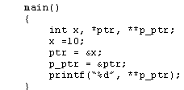

Multiple Indirection
A pointer to another pointer that points to the target value is called multiple indirection or pointers to pointers.
Example:
In the memory:

Slide 31
Pointers to Functions (1)
Even though a function is not a variable, it has a physical location in memory that can be assigned to a pointer.
A function’s address is the entry point of the function. Because of this, a function pointer can be used to call a function.
The address of a function can be obtained by using the function’s name without any parentheses or arguments.

Slide 32
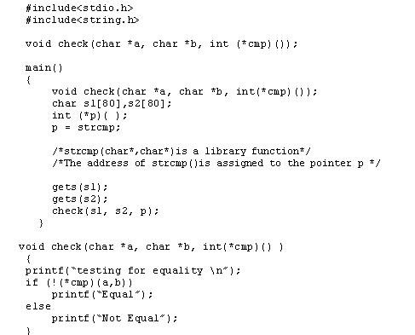
Pointers to Functions (2)

